Slide 1
Multi instance RAG
Group members: Danerson Teh 2370276-DCS
Phoon Yew Fai 2370265-DCS
Lai Jun Cheng 2370293-DCS
Wong Weng Hong 2390009-DCS

Slide 2
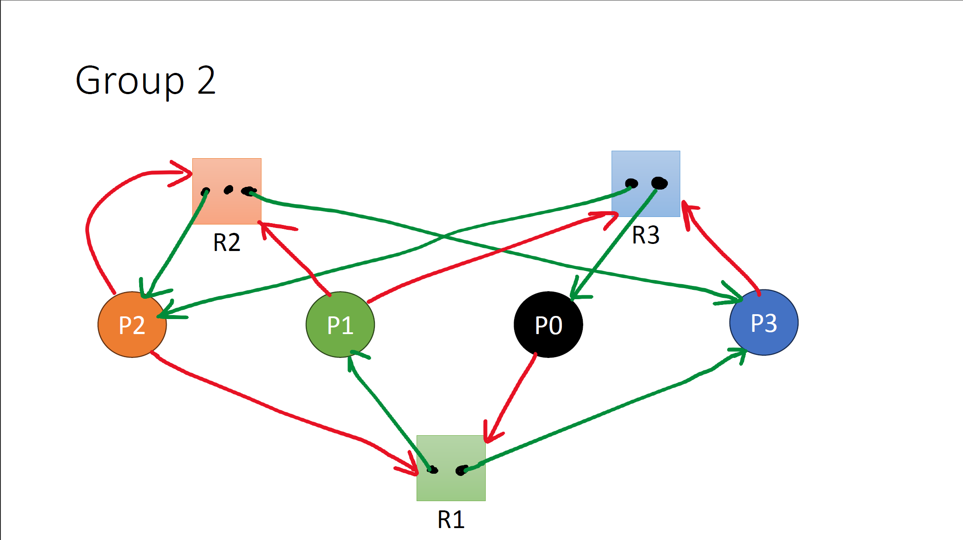
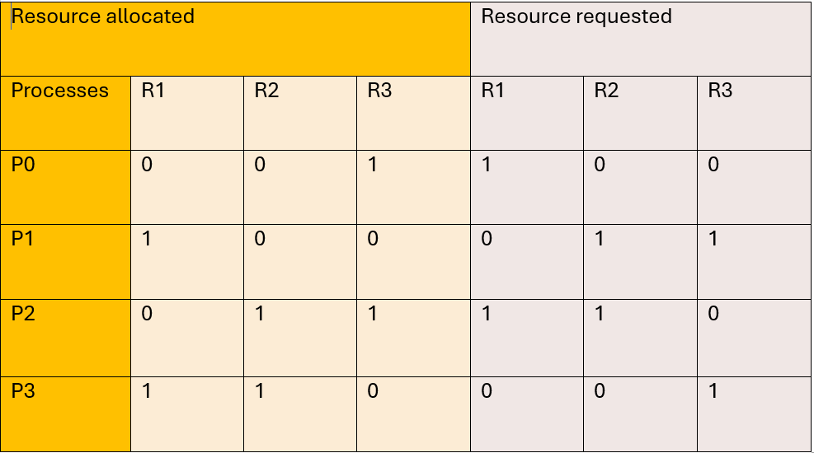
Resource availability: (0,1,0)

Slide 3
Resource availability: (0,1,0)

Slide 4
Resource availability: (0,1,0)
Cause of deadlock:
P0 allocates R3, requested R1, but R1 is allocated by P1 and P3
P1 allocates R1, requested R2 and R3, R2 can be successfully requested but R3 is allocated by P0 and P2
P2 allocates R2 and R3, requested R1 and R2, R2 can be successfully requested but R1 is allocated by P1 and P3
P3 allocates R1 and R2, requested R3, but R3 is allocated by P0 and P2
No process are able to proceed,
deadlock occurs
Ways to overcome deadlock:
Preemption
Circular wait
Spooling
Hold n wait

Slide 5
Cause of deadlock:
P0 allocates R3, requested R1, but R1 is allocated by P1 and P3
P1 allocates R1, requested R2 and R3, R2 can be successfully requested but R3 is allocated by P0 and P2
P2 allocates R2 and R3, requested R1 and R2, R2 can be successfully requested but R1 is allocated by P1 and P3
P3 allocates R1 and R2, requested R3, but R3 is allocated by P0 and P2
No process are able to proceed,
deadlock occurs
Ways to overcome deadlock:
Preemption
!(Circular wait)
Spooling
!(Hold n wait)

Slide 6
Ways to overcome deadlock:
Preemption
Circular wait
Spooling
!(Hold n wait)

Slide 7
!(Hold n wait)

Slide 8




!(Hold n wait)

Slide 9
!(Hold n wait)
After releasing R3,
Resource availability: (0,1,1)
P3 process started resource availability: (0,1,0)
P3 process finished, released
resource availability: (1,2,1)
P0 process started resource availability: (0,2,1)
P0 process finished, released resource availability: (1,2,1)
P1 process started
resource availability: (1,1,0)
P1 process finished, released
resource availability: (2,2,1)
P2 process started
resource availability: (1,1,1)
P2 process finished, released
resource availability: (2,3,2)
All process done,
no deadlock

